Slide 1
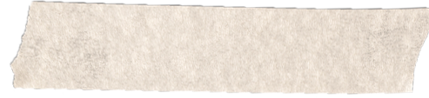
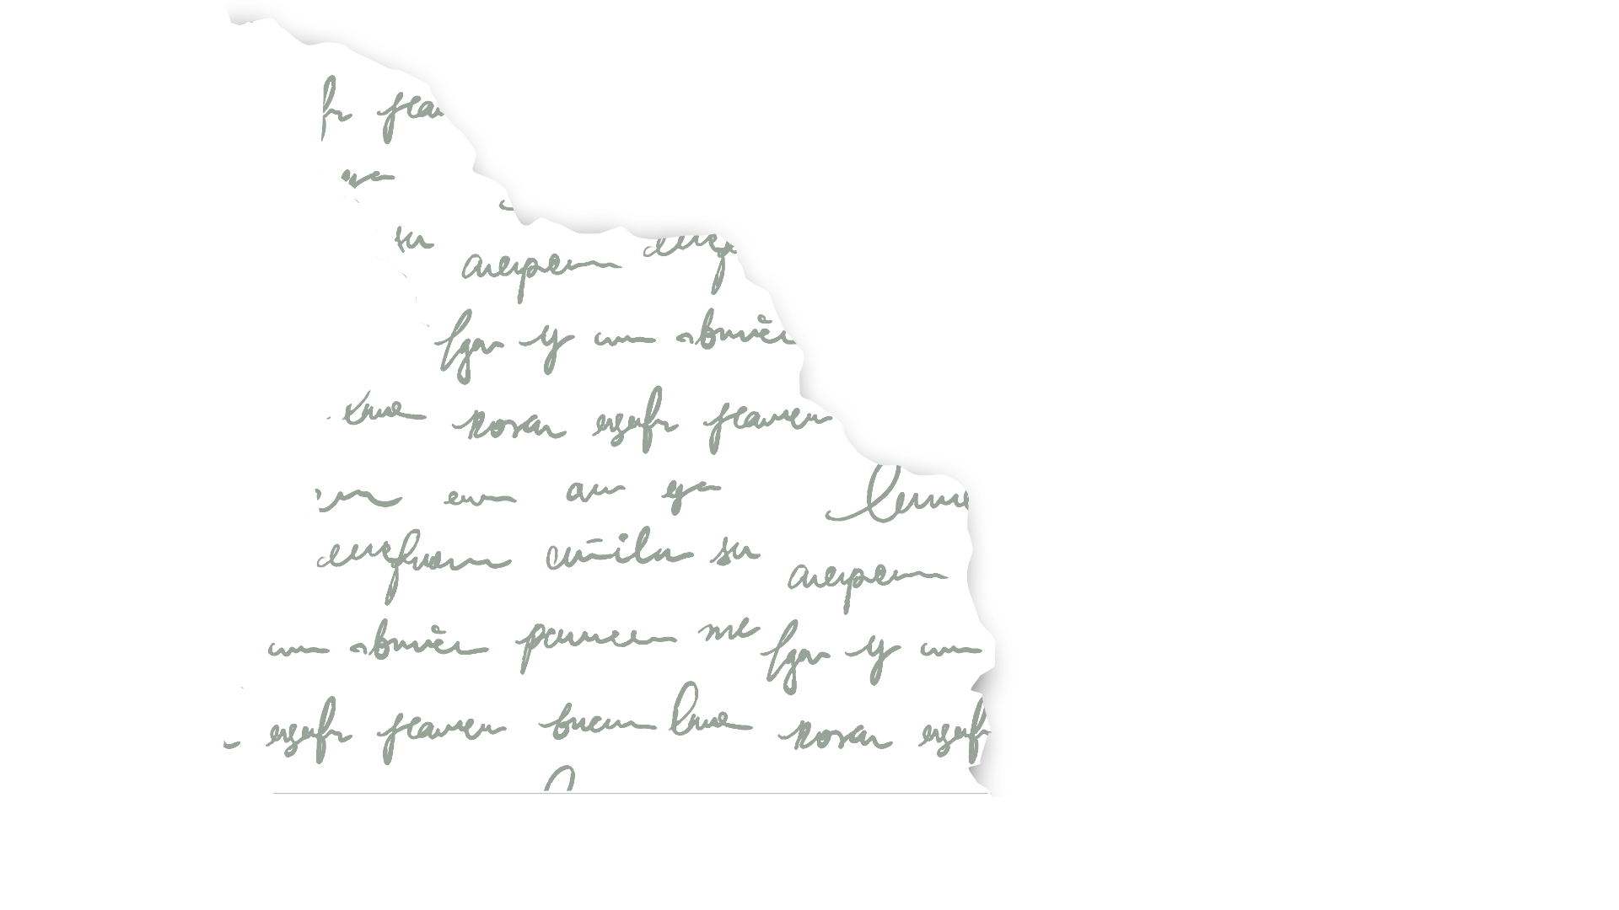
SUM-CHECK PROTOCOL GKR PROTOCOL
Sota ZK
VanhGer

Slide 2
Contents
Overview
GKR Protocol
1XXX
2XXX
3XXX
Sum-check Protocol

Slide 3
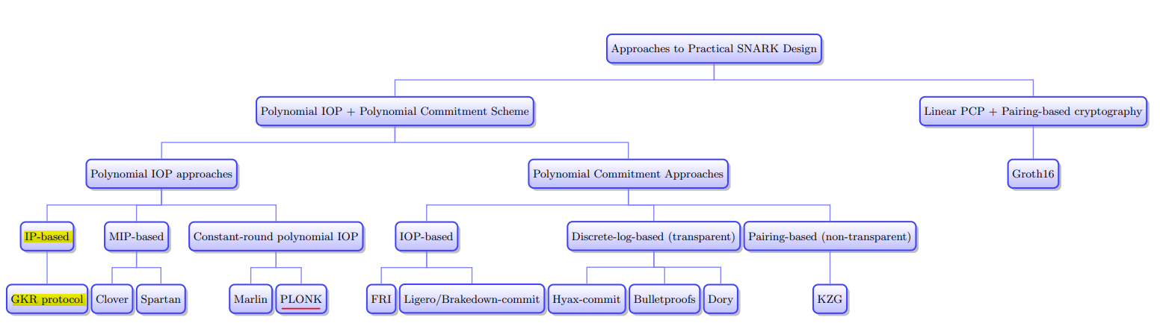
Overview

Slide 4
Overview
Polynomial IOP approaches | Polynomial Commitment Approaches | SNARK | Applications
IPs | FRI-based (multilinear) polynomial commitments | Virgo | THUBA DAO, PolyHedra
IPs | Bulletproofs, Hyrax-commit | Hyrax
IPs | KZG-based | zk-vSQL and Libra

Slide 5
SUM-CHECK PROTOCOL

Slide 6
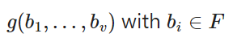
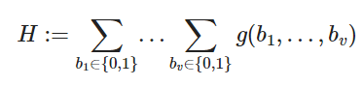
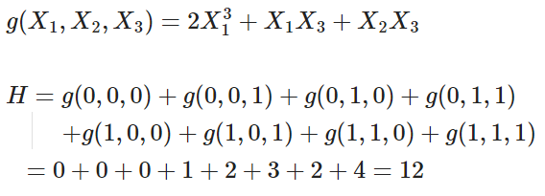
Sum-check Protocol
Purpose: Suppose we are given a v-variate polynomial g defined over a finite field F
Prover provides this sum for verifier:
Example:
Verify: O(2＾v): slow

Slide 7
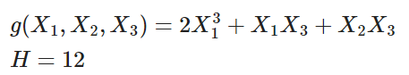


Sum-check Protocol
How it works:
Example:
First, Prover sends a value C claimed to equal the value H.
C = 12
Prover
Verifier

Slide 8
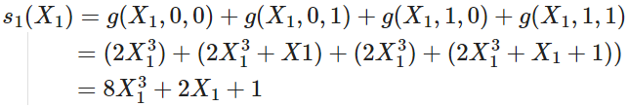
Sum-check Protocol
How it works:
Round1:
Prover sends an univariate polynomial s1(X1) to Verifier
s1(X1)
Prover
Verifier

Slide 9
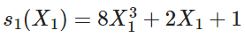
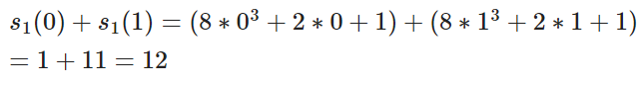
Sum-check Protocol
How it works:
Round1:
Then, Verifier checks that: s1(0) + s1(1) = C (= 12) ? OK
Verifier sends a random value R1 = 2 corresponds to X1 to prover.
s1(X1)
R1 = 2
Prover
Verifier

Slide 10
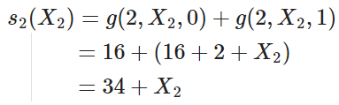
Sum-check Protocol
How it works:
Round2:
Prover sends s2(X2):
s1(X1)
R1 = 2
s2(X2)
Prover
Verifier

Slide 11
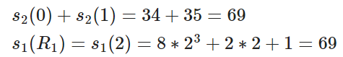
Sum-check Protocol
How it works:
Round2:
Then, Verifier checks that:
s2(0) + s2(1) = s1(R1) ? OK
Verifier sends a random value R2 = 3 corresponds to X2 to prover.
s1(X1)
R1 = 2
s2(X2)
R2 = 3
Prover
Verifier

Slide 12
Sum-check Protocol
How it works:
Round3:
Prover sends s3(X3):
s1(X1)
R1 = 2
s2(X2)
R2 = 3
Prover
s3(X3)
Verifier

Slide 13
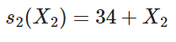
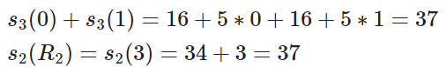
Sum-check Protocol
How it works:
Round3:
Then, Verifier checks that: s3(0) + s3(1) = s2(R2) ? OK
s1(X1)
R1 = 2
s2(X2)
R2 = 3
Prover
s3(X3)
Verifier

Slide 14
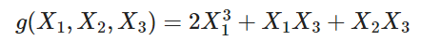
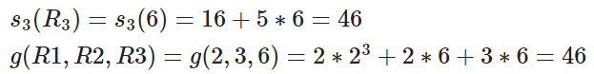
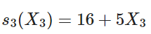
Sum-check Protocol
Final check
How it works:
Round3:
Then, Verifier chooses a random value R3 = 6 and checks that: s3(R3) = g(R1, R2, R3) ? OK
Verifier accepts
s1(X1)
R1 = 2
s2(X2)
R2 = 3
Prover
s3(X3)
Verifier
Accepted

Slide 15
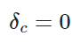
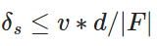
Sum-check Protocol
Completeness error:
Soundness error:
Cost:
Schwartz Zippel Lemma

Slide 16
GKR PROTOCOL

Slide 17
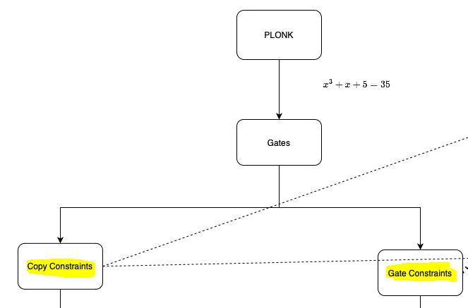
GKR Protocol
- As in PLONK, to check the correctness of the circuit, we need to check the Copy Constraints and Gate Constraint.
- There is another way to check this correctness, which is using GKR Protocol

Slide 18
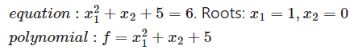
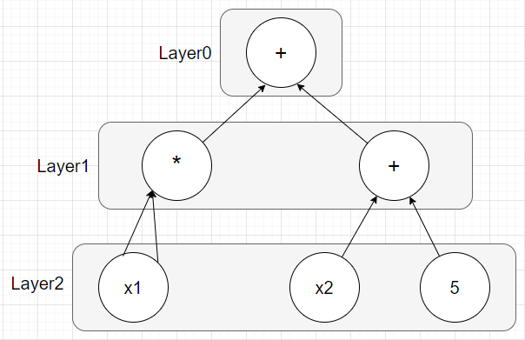
GKR Protocol
First, Prover changes the polynomial:
to an arithmetic circuit and numbers the layer:

Slide 19
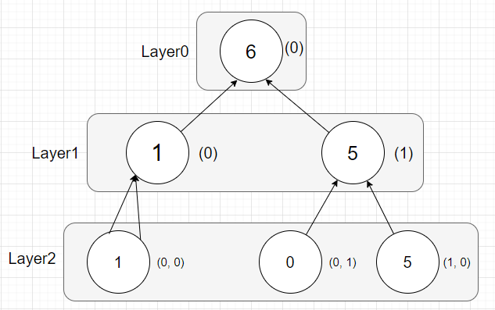
GKR Protocol
Then, Prover computes the output of each gates using roots:
To check the correctness of this circuit, Prover need to check the correctness of the first layer.

Slide 20
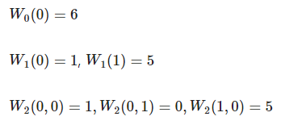
GKR Protocol
Prover defines some polynomial:
Wi: function that takes as input a binary gate label, and outputs the corresponding gate’s value at layer i
Example:

Slide 21
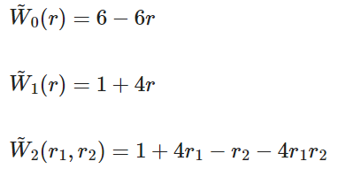
GKR Protocol
Using Lagrange interpolation and MLE, Prover has:

Slide 22
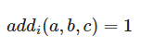
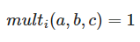
GKR Protocol
Prover defines some polynomial:
add_i , mult_i: - if gate a at layer i computes the sum of gates b and c at layer i+1:
- if gate a at layer i computes the product of gates b and c at layer i+1:
- else they all = 0.

Slide 23
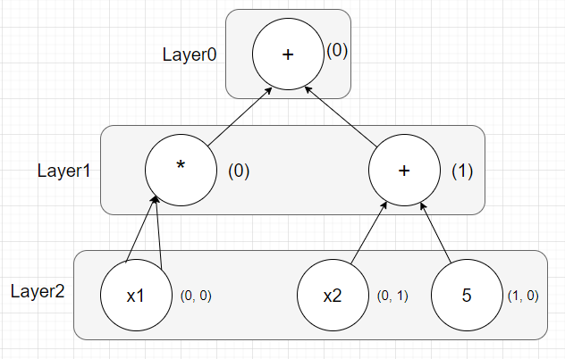
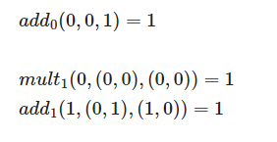
GKR Protocol
Prover defines some polynomial:
add_i , mult_i:

Slide 24
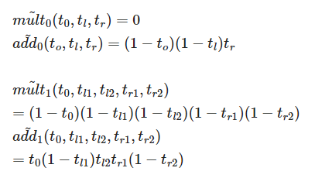
GKR Protocol
Using Lagrange interpolation and MLE, Prover has:
add_i , mult_i:

Slide 25
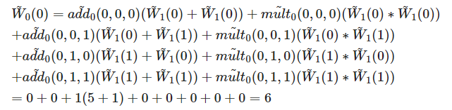
GKR Protocol
Example:

Slide 26
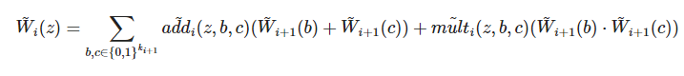
GKR Protocol
So Prover can compute the value of each gate z of layer i:
:

Slide 27
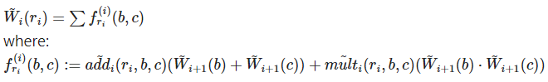
GKR Protocol
We see that if Prover has a random gate ri, he can evaluate Wi(ri) via:
=> Look like sum-check protocol:

Slide 28
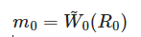
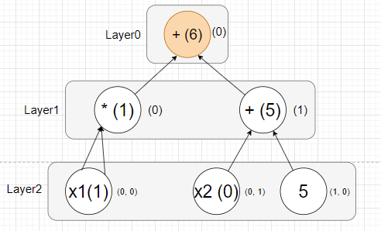
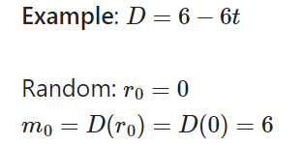
GKR Protocol
How it works:
First, Prover sends a function D: claimed to equal W0.
Verifier picks a random R0, for example R0 = 0 and let m0 = D(R0).
Now, need to confirm that:
Example:

Slide 29
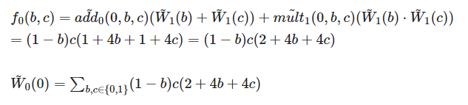
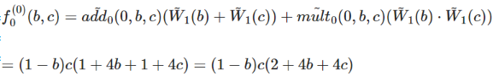
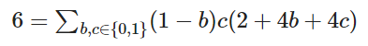
GKR Protocol
How it works:
Round1:
With the random R0 = 0, Prover compute a polynomial:
Now, Prover starts sum-check protocol to claim that:

Slide 30
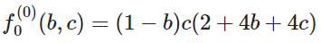
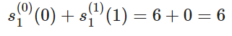
GKR Protocol
How it works:
Round 1.1
Prover sends an univariate polynomial:
Verifier checks if: s1(0) + s1(1) = 6 ? OK
Verifier choose a random value X1 = 1 corresponding to b and sends to P

Slide 31
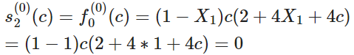
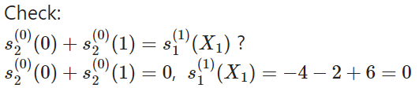
GKR Protocol
How it works:
Round 1.2
Prover sends an univariate polynomial s2(c):
Verifier checks if:

Slide 32
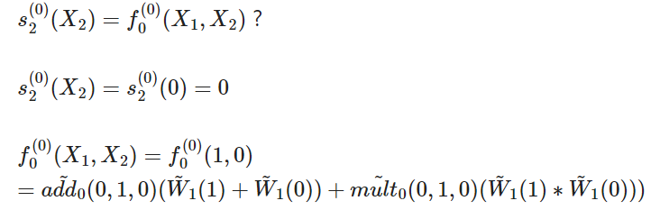
GKR Protocol
How it works:
Round 1.2
Final check: Verifier chooses a random value X2 = 0 corresponding to c and check:

Slide 33
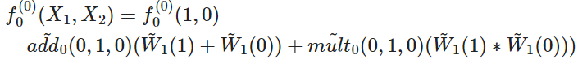
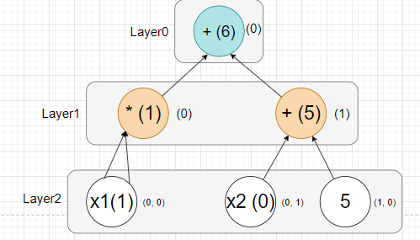
GKR Protocol
How it works:
Note that to compute add0, mult0, Verifier only needs to indicate to layer 1.
But to evaluate W1(0), W1(1), Verifier needs to compute layer 1, and 2, ….
So we need to reduce from evaluating from 2 points to 1.

Slide 34
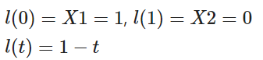
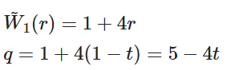
GKR Protocol
How it works:
Round 1.3
Let l be the line that:
Prover send a polynomial q, mean the restriction of W1 in l.

Slide 35
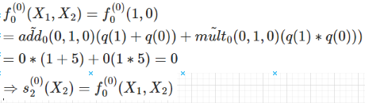
GKR Protocol
How it works:
Round 1.3
Then, instead of evaluating W1(0) and W1(1), Verifier can use q(0) and q(1).
Verifier accepts.

Slide 36
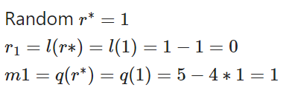

GKR Protocol
How it works:
Round 2
To verify that q is actually the restriction of W1 in l, Verifier choose a random r*:

Slide 37

GKR Protocol
How it works:
Round 2
Then, Prover can apply sum-check protocol with verifier to check.

Slide 38



GKR Protocol
How it works:
Round 3

Slide 39
GKR Protocol
How it works:
Round 3
Then, V can accept or reject.

Slide 40



GKR Protocol
How it works:
V’s runtime:
P’s runtime:

Slide 41
Thank for your listening

